Slide 1
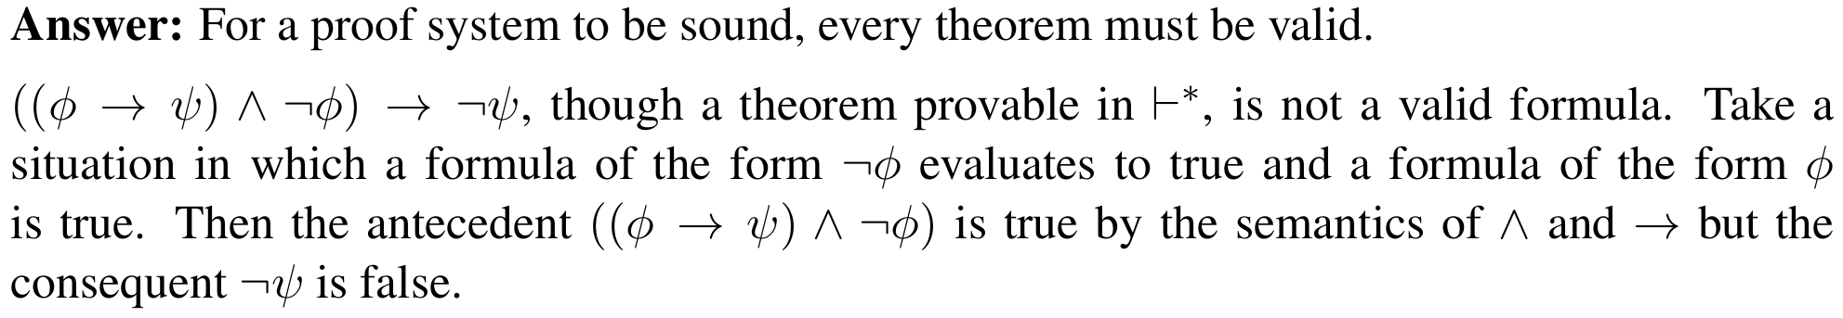
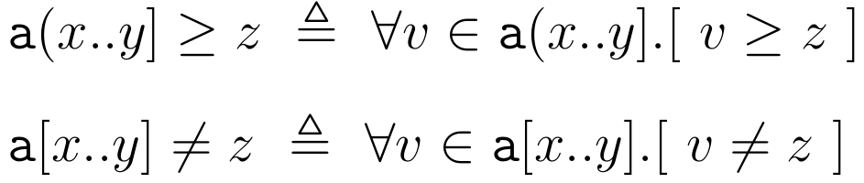
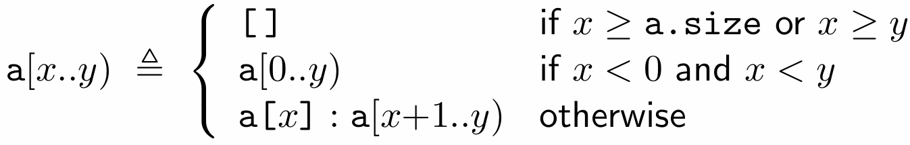
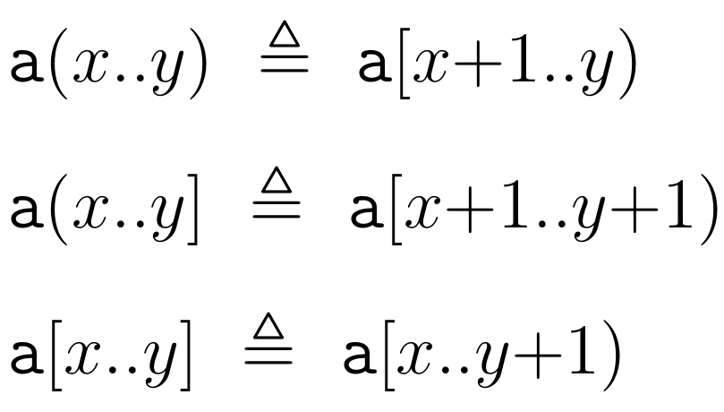
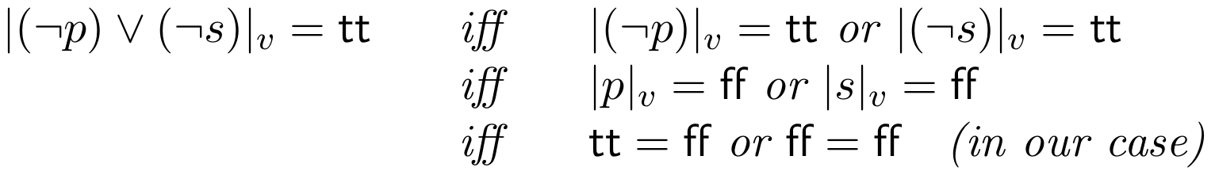




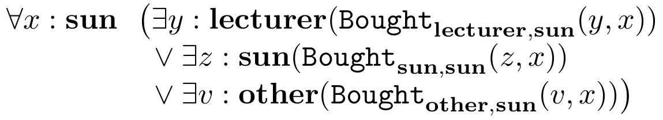


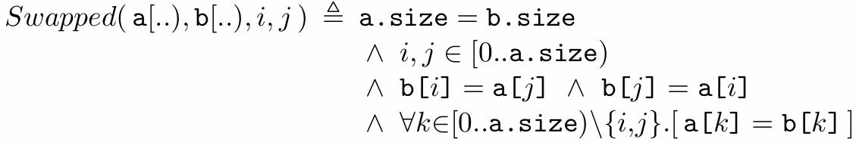
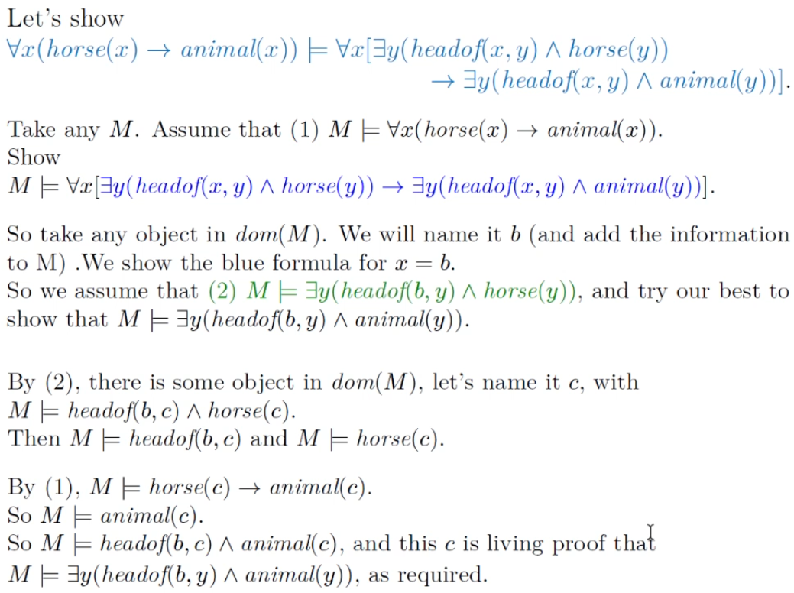
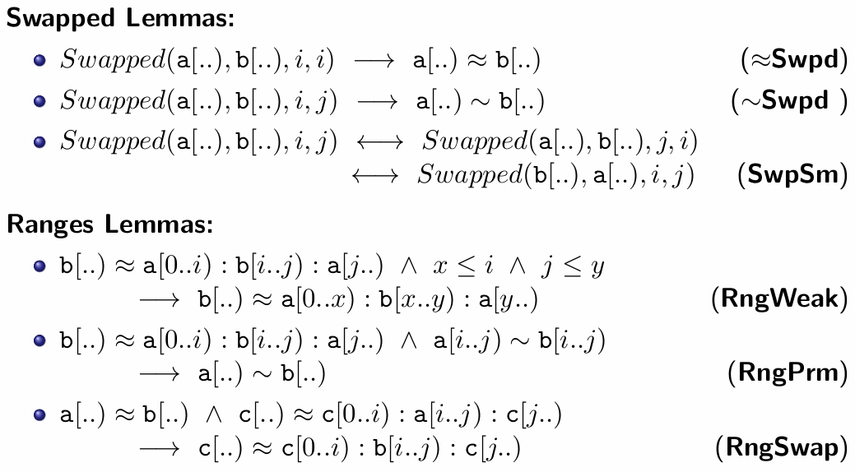

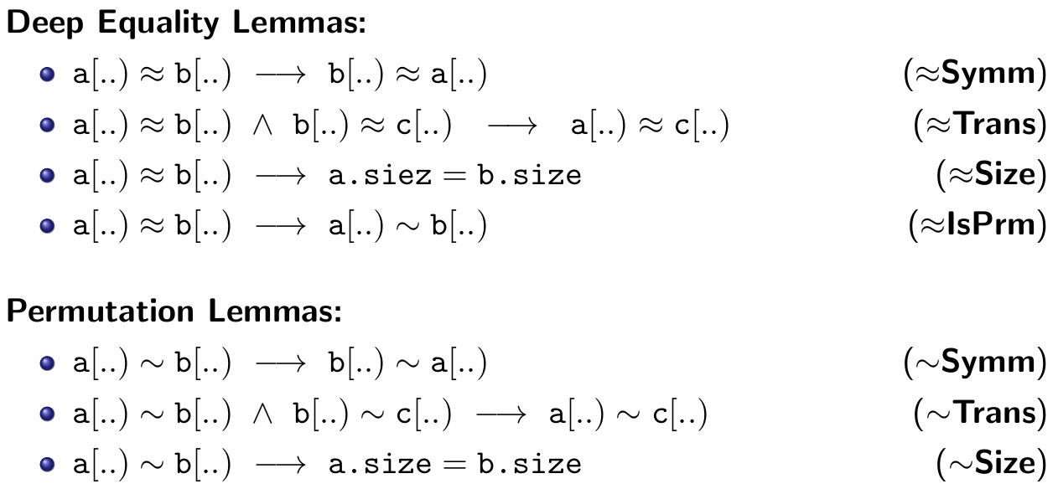

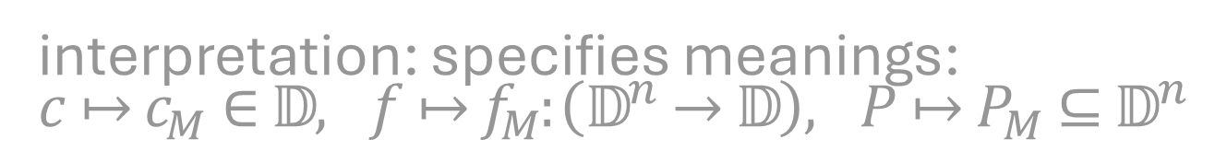
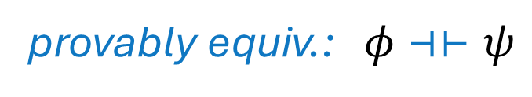

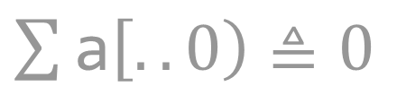
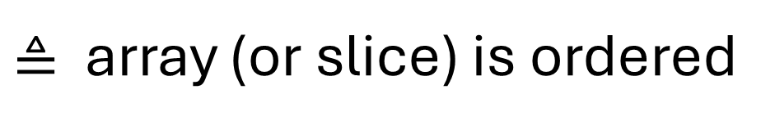


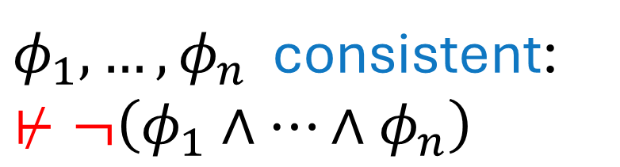
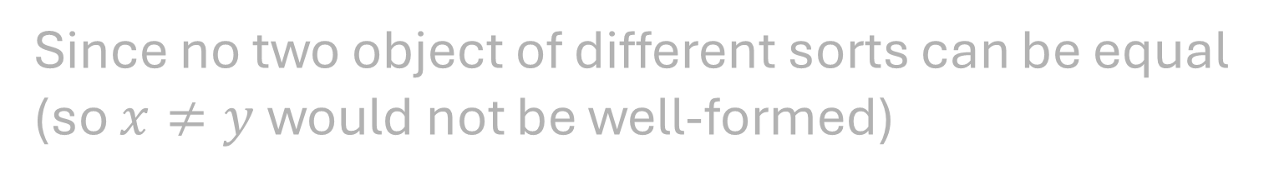
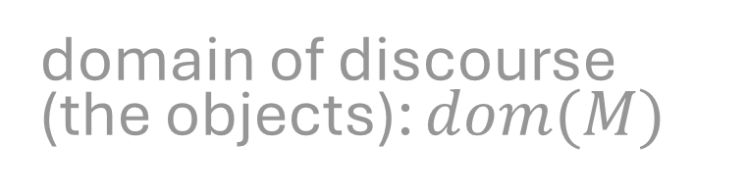
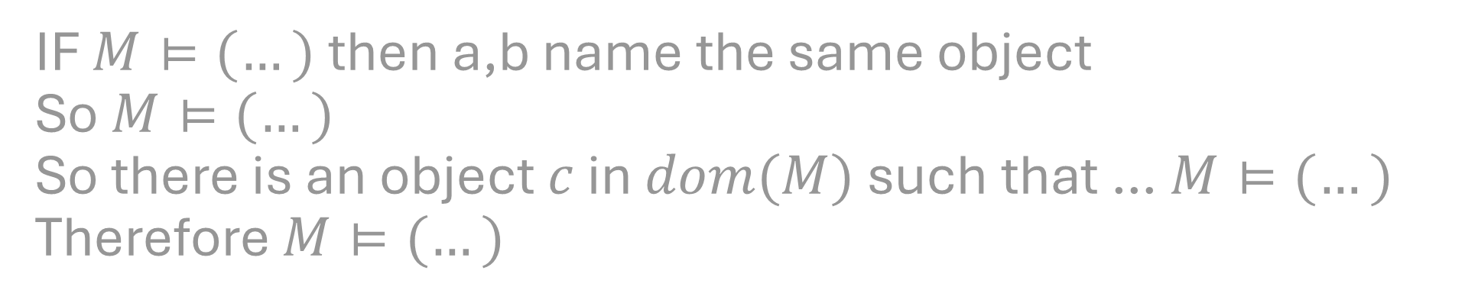
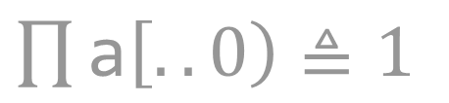
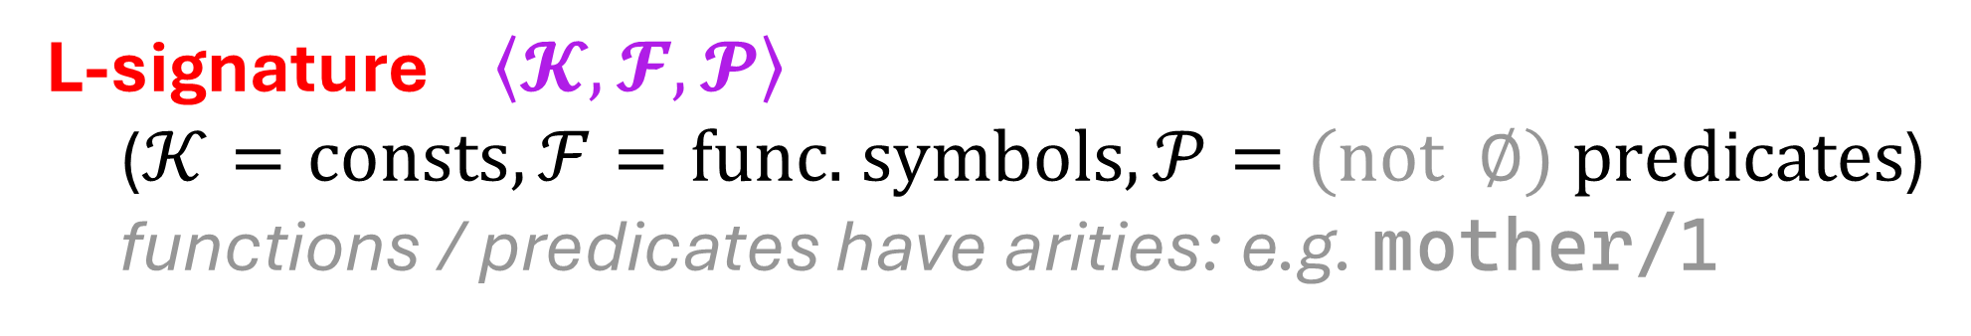

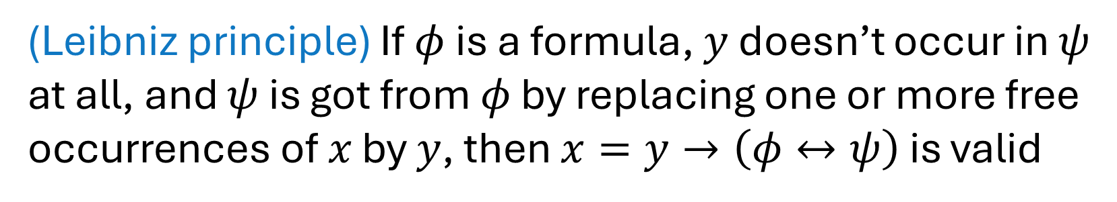


premise
consequent
$$φ ⊢ ψ$$
sequent
array a
values $v, z$
$x,y∈ℕ$
(Leibniz principle) If $φ$ is a formula, $y$ doesn’t occur in $ψ$ at all, and $ψ$ is got from $φ$ by replacing one or more free occurrences of $x$ by $y$, then $x=y→\left(φ↔ψ\right)$ is valid
provably equiv.: $φ⊣⊢ψ$
array slice ≜ a[x..y) (closed-open interval) (NB: prefered)
Show that $M,h_{4}⊨∀x ∃y R(x,y)$
For this to be true, we require $M,g⊨∃y R(x,y)$ for every assignment $g$ over $M$ with $g=_{x}h_{4}$
These are: $h_{4},h_{5}, h_{6}$
$M,h_{4}⊨∃y R(x,y)$, because
$h_{4}=_{y}h_{4}$ and $M,h_{4}⊨R(x,y)$
$M,h_{5}⊨∃y R(x,y)$, because
$h_{8}=_{y}h_{5}$ and $M,h_{8}⊨R(x,y)$
(…)
So indeed, $M,h_{4}⊨∀x ∃y R(x,y)$
$φ_{1},…,φ_{n}$ consistent: $⊬¬\left(φ_{1}∧…∧φ_{n}\right)$
iff
satisfiable
Direct arg: satisfiability
show $f\left(x,f\left(y,z\right)\right)=f\left(f\left(x,y\right),z\right)$ satisfiable
Find structure $M$ and assignment $h$ over $M$ in which the formula is true
Take an $M$ where $dom\left(M\right)$ is natural numbers $ℕ$ and the value of $f$ in $M$ is addition $+$.
Let $h$ be assgnmt. in which vals of $x,y,z$ are $2,4,9$
Then $M,h⊨f\left(xf\left(y,z\right)\right)=f\left(f\left(x,y\right), z\right)$
$\text{a}\left[..i\right)≜\text{a}\left[0..i\right)$
$\text{a}\left[i..\right)≜\text{a}\left[i..\text{a.size}\right)$
$\text{a}\left[..\right)≜whole array$
Suppose $v(p) =\text{tt}$, $v(q) =\text{tt}$ and $v(s) =\text{ff}$in a certain situation. Does $¬p∨¬s$ evaluate to true or false in this situation? Show your working
array operations
$\sum{\text{a}\left[..0\right)}≜0$
Make sure your array access is LEGAL!
(or any empty slice)
array predicates
$\prod{\text{a}\left[..0\right)}≜1$
$≜$ array (or slice) is ordered
only well-defined for [x..y) that lie within bounds of a.
only well-defined on array of comparable contents (e.g. Int)
array min / max
$$⊤$$
only defined for comparable contents
Since no two object of different sorts can be equal (so $x≠y$ would not be well-formed)
array concatenation
L-signature $\left\langle 𝓚,𝓕,𝓟\right\rangle$
($𝒦=\text{consts},ℱ=\text{func. symbols},𝒫=\text{(not } ∅\text{)} \text{predicates}$)
functions / predicates have arities: e.g. mother/1
$$≜$$
domain of discourse (the objects): $dom(M)$
interpretation: specifies meanings:
$c↦c_{M}∈𝔻,$ $f↦f_{M}:\left(𝔻^{n}→𝔻\right),$ $P↦P_{M}⊆𝔻^{n}$
IF $M⊨(…)$ then a,b name the same object
So $M⊨(…)$
So there is an object $c$ in $dom(M)$ such that … $M⊨(…)$
Therefore $M⊨(…)$
shorthands
$NrOccurs(\text{a}[..),v)$ | # occurrences of $v$ in a | $\left| \left\{ k | \text{a}\left[k\right]=v \right\} \right|$
$$\text{a}\left[..\right)∼\text{b}\left[..\right)$$ | (contents of) a are 'permutation of' (contents of) b | $∀v.\left[ NrOccurs\left(a\left[..\right),v\right)=NrOccurs\left(b\left[..\right),v\right) \right]$
$$\text{a}\left[..\right)≈\text{b}\left[..\right)$$ | contents of a and b identical 'deep equality' | $\text{a.size} =\text{b.size}$ $∧$ $∀j∈[0..\text{a.size}).[ \text{a}\left[j\right]=\text{b}\left[j\right] ]$

Slide 2
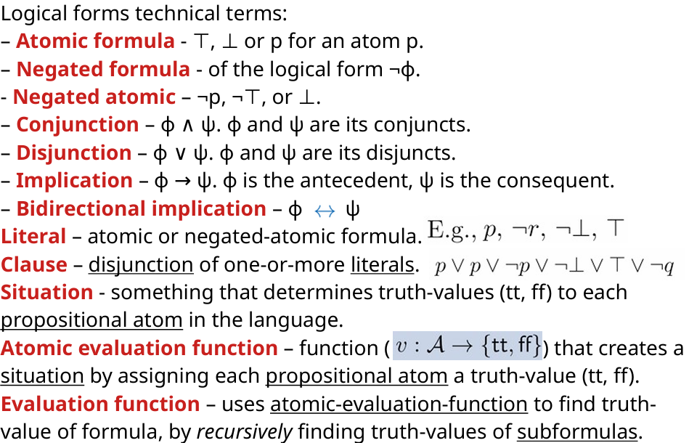
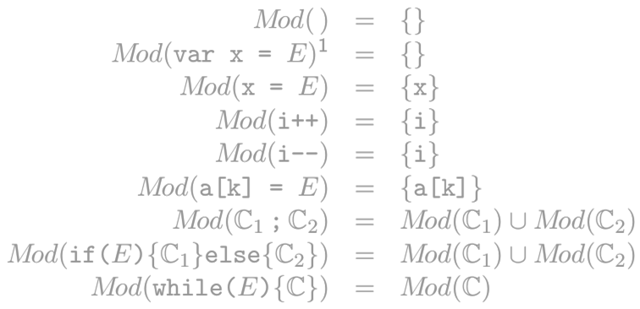
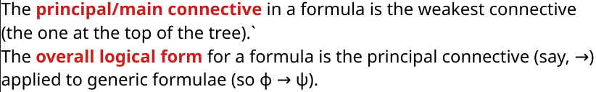
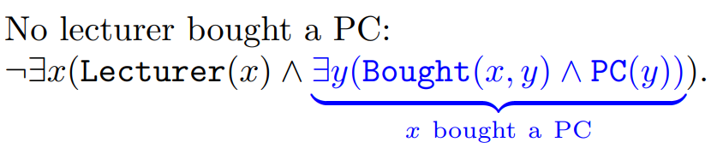
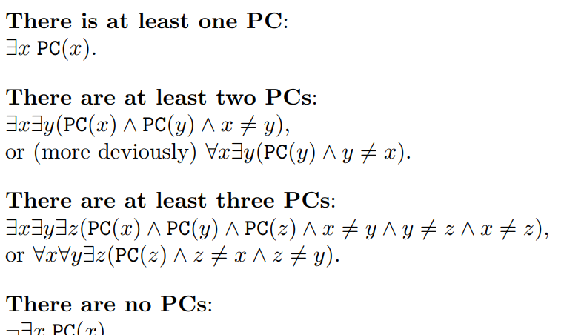
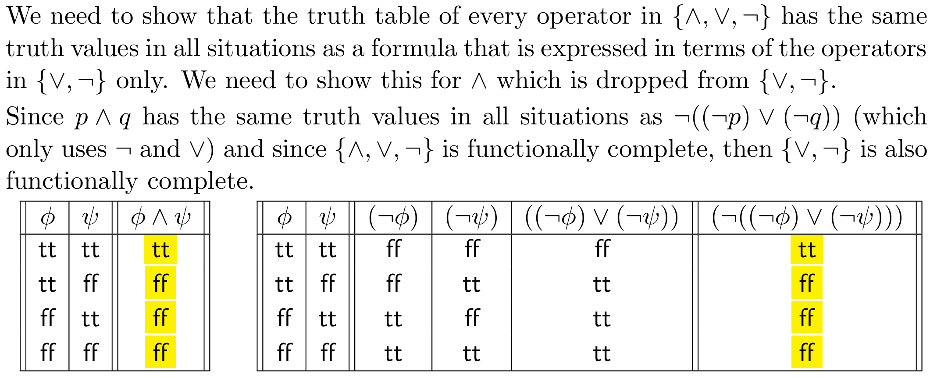

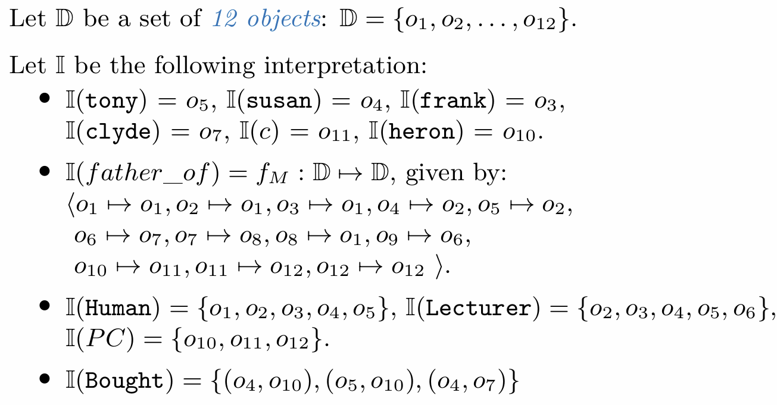
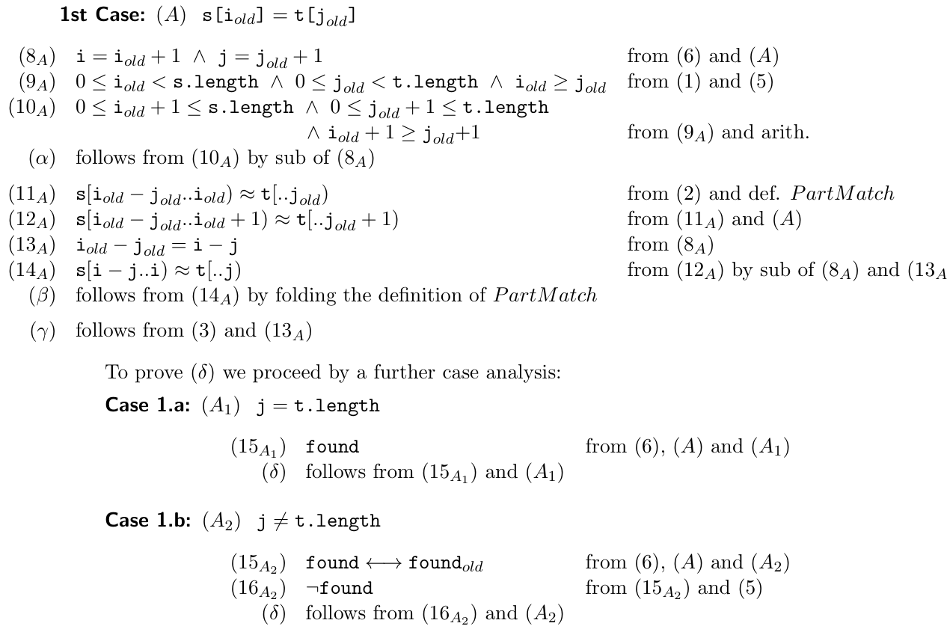
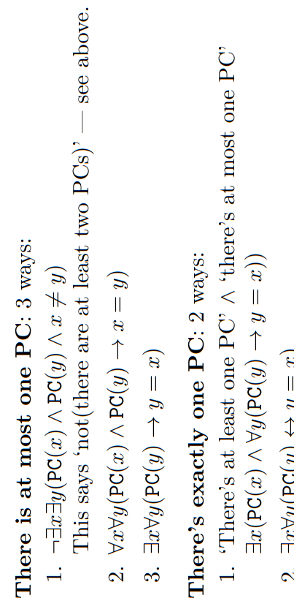
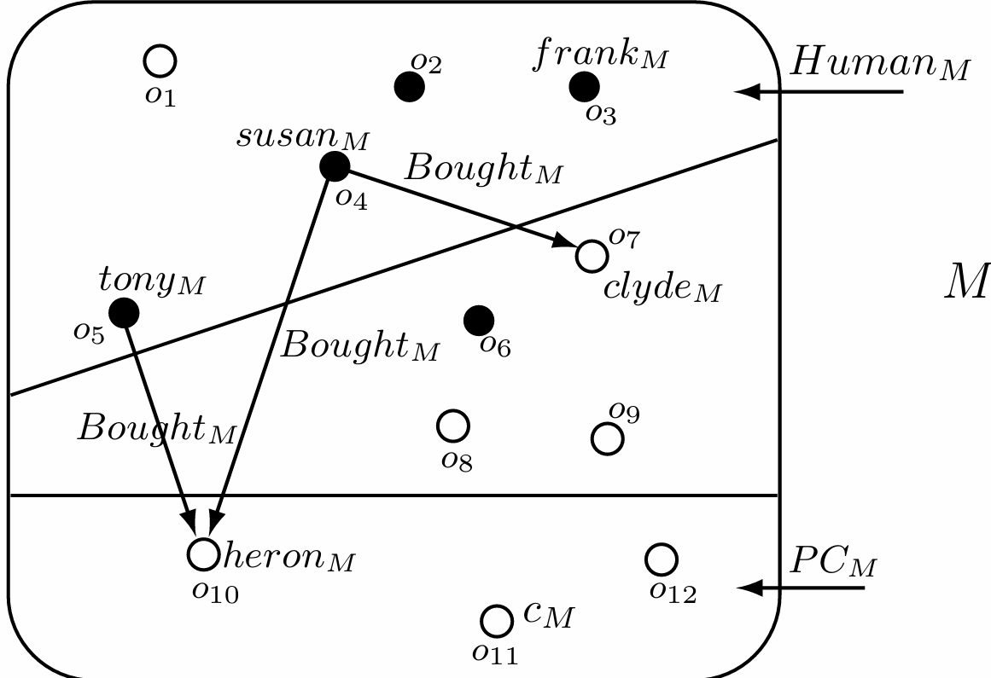
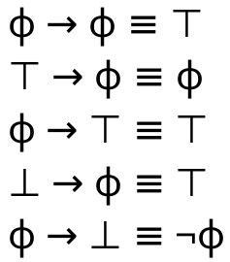
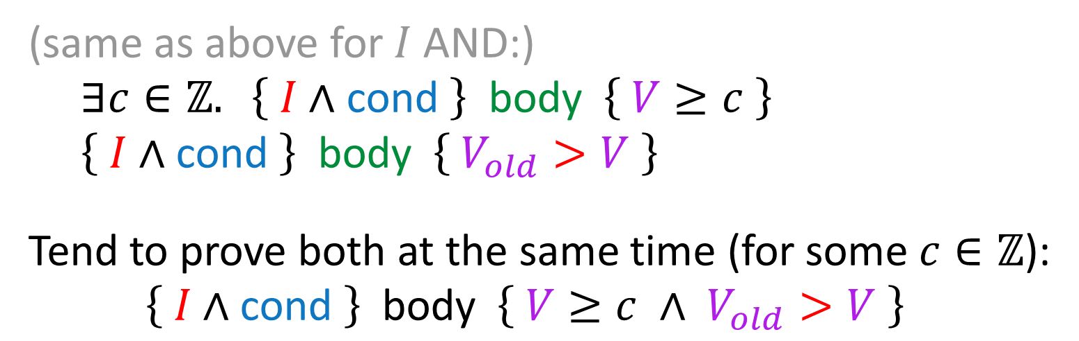
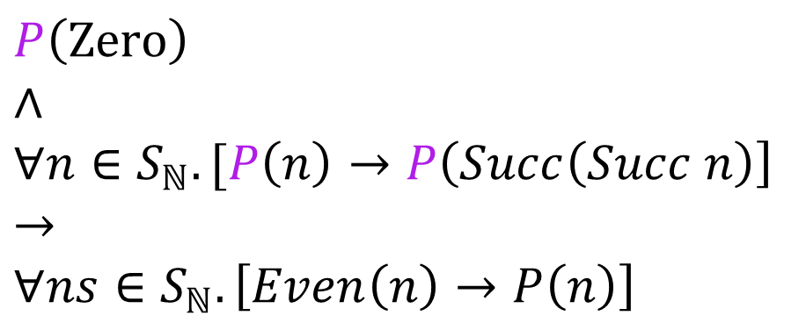
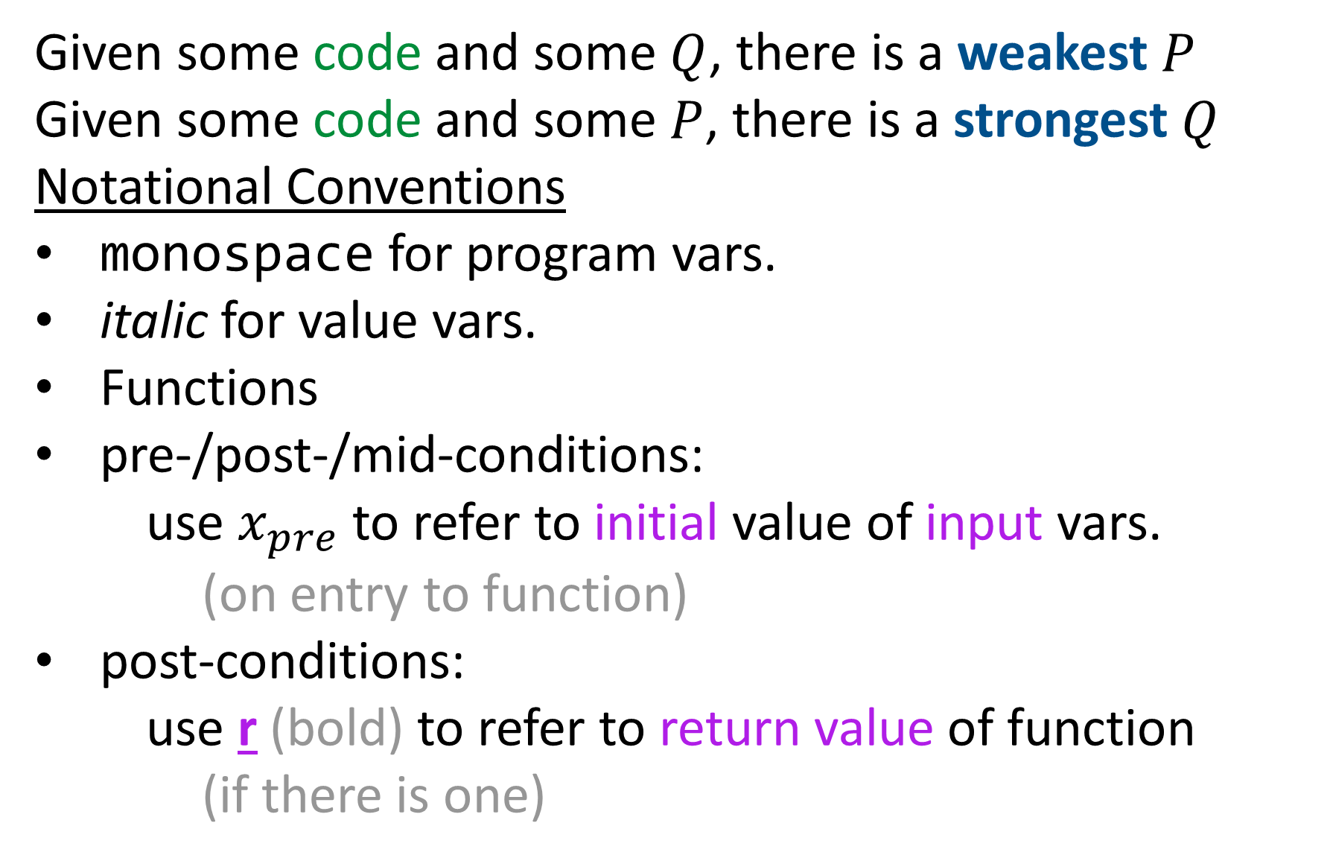
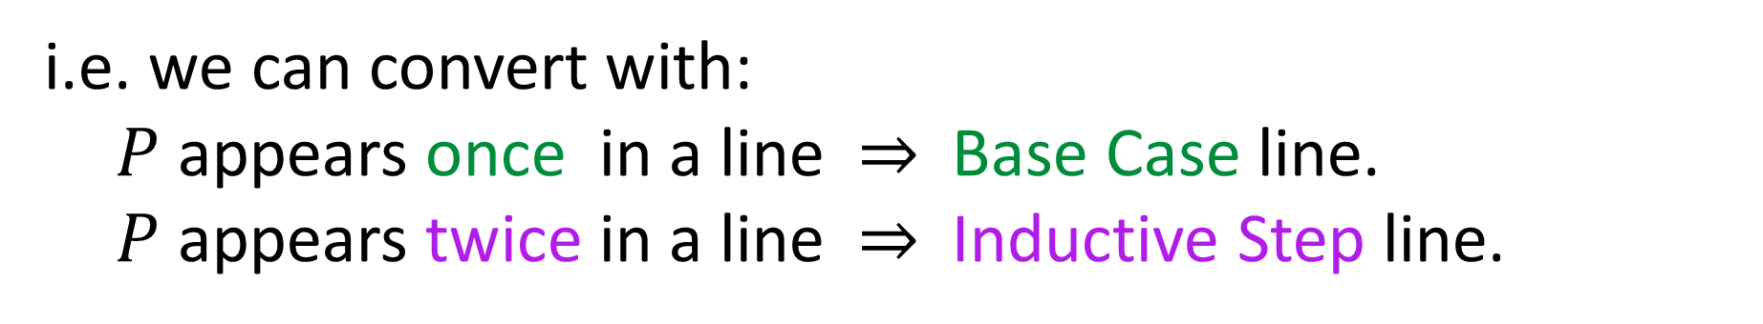
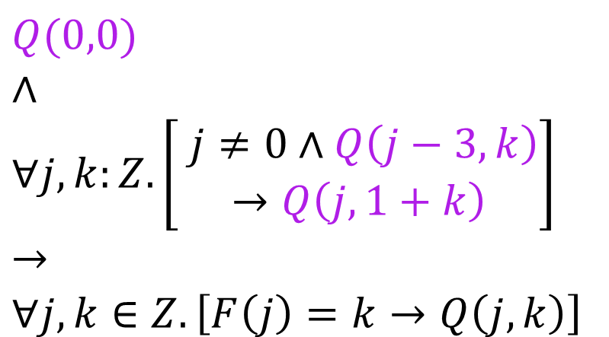
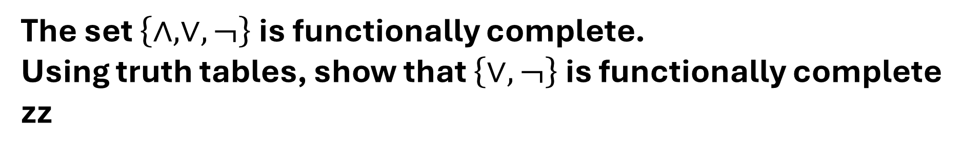
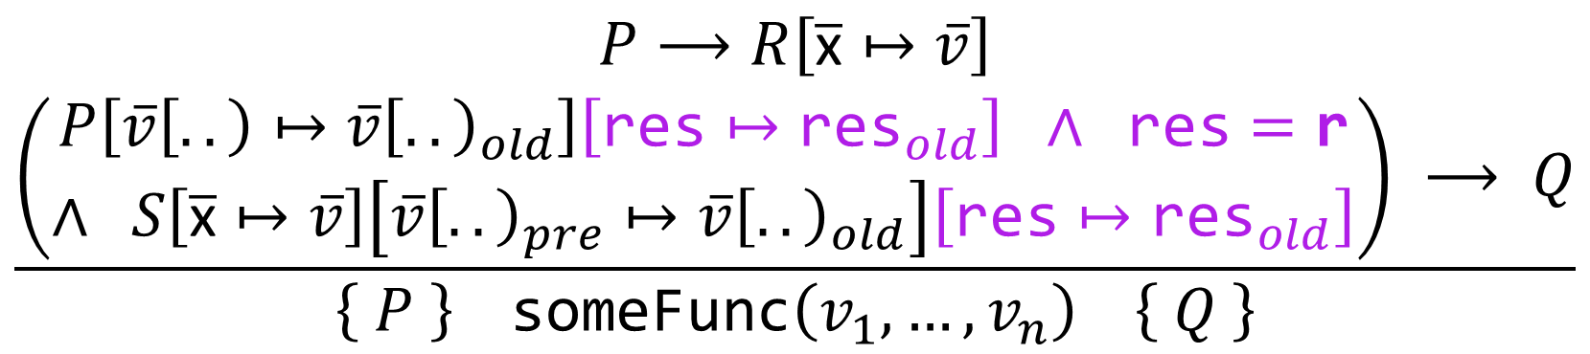
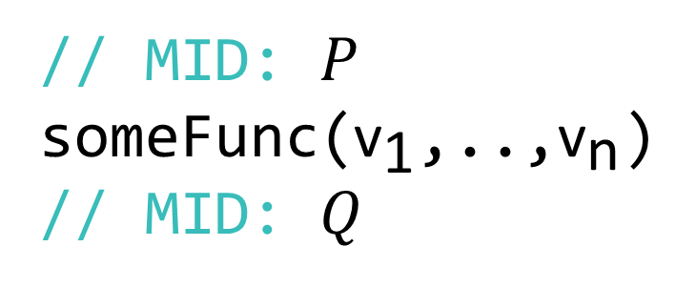
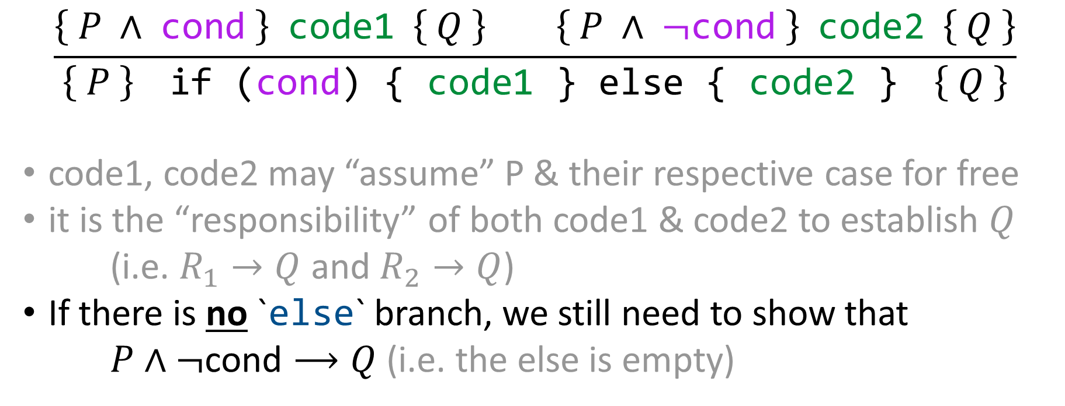
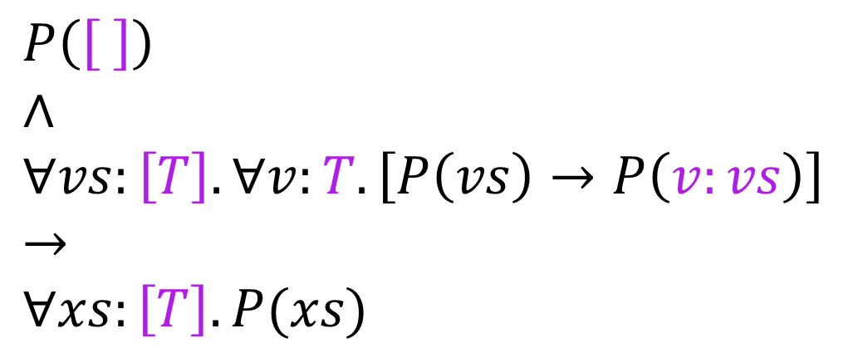
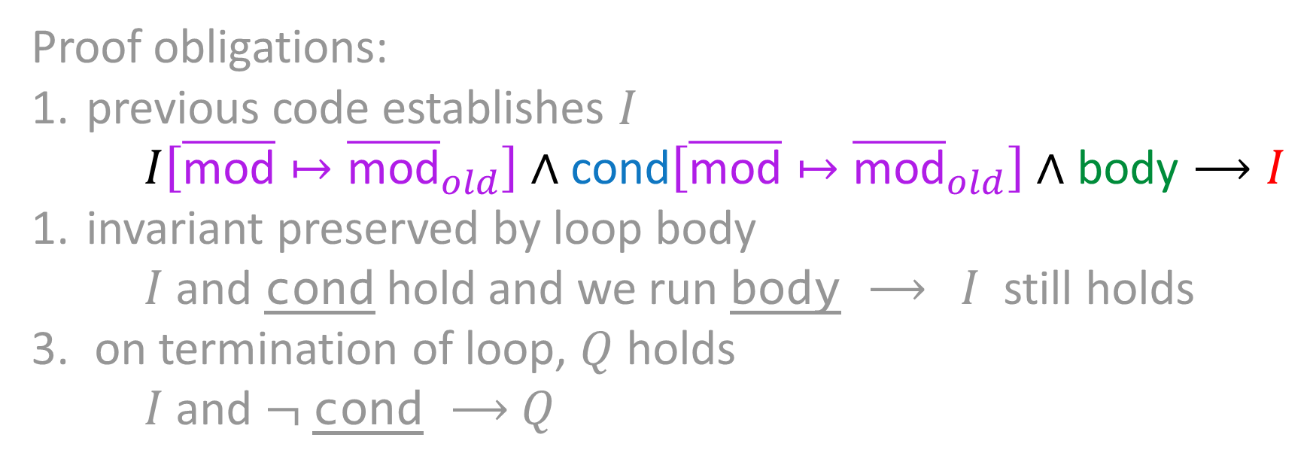


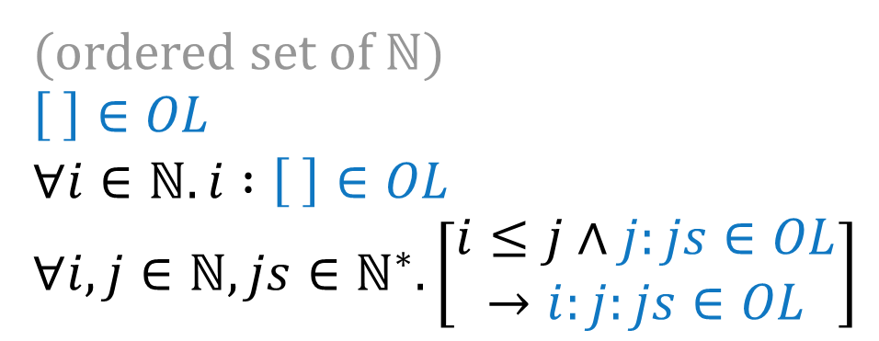


























$Mod:ℂ→℘ID$
(set of variables/object-attributes that are modified by a piece of code)
$ℂ,ℂ_{1},ℂ_{2}$ : sequences of instructions.
$ID$ : the set of variables/identifiers
Given some code and some $Q$, there is a weakest $P$
Given some code and some $P$, there is a strongest $Q$
Notational Conventions
monospace for program vars.
italic for value vars.
Functions
pre-/post-/mid-conditions:
use $x_{pre}$ to refer to initial value of input vars.
(on entry to function)
post-conditions:
use r (bold) to refer to return value of function
(if there is one)
Induction
List Lemmas:
(A) us++[]=us
(B) []++us=us
(C) (u:us)++vs=u:(us++vs)
(D) (us++vs)++ws=us++(vs++ws)
PROOF STRUCTURE
Given: …
To show: …
Explicit steps. Justify each step (properties, assumptions, lemmas)
Name intermediate results ((1), (ass1), etc)
[for induction] say which var. you apply the induction principle on
"Vary granularity of proof steps according to confidence and circumstances“
Stuck during induction?:
Invent (and prove) the auxiliary lemma you need
'Strengthen the lemma': prove a stronger property (which implies the thing you want) (get rid of 0, [], etc in the assertion & replace w/ vars)
(move your quantifiers around?...)
$E$ : side-effect-free expression
// PRE: $P$
if (cond) {
// MID: $P$ ∧ cond
code1
// MID: $R_{1}$
} else {
// MID: $P$ ∧ ¬cond
code2
// MID: $R_{2}$
}
// POST: $Q$
Conditional Branches (if-else)
Mathematical induction (all are equivalent)
The set $\left\{∧,∨, ¬\right\}$ is functionally complete.
Using truth tables, show that $\left\{∨,¬\right\}$ is functionally complete
zz
$$\frac{\left\{ P ∧ \text{cond} \right\} \text{code1} \left\{ Q \right\} \left\{ P ∧ ¬\text{cond} \right\} \text{code2} \left\{ Q \right\}}{\left\{ P \right\} \text{if} \text{(}\text{cond}\text{)} \text{\{} \text{code1} \text{\}} \text{else} \text{\{} \text{code2} \text{\}} \left\{ Q \right\}}$$
code1, code2 may “assume” P & their respective case for free
it is the “responsibility” of both code1 & code2 to establish $Q$
(i.e. $R_{1}→Q$ and $R_{2}→Q$)
If there is no `else` branch, we still need to show that
$P∧¬\text{cond}⟶Q$ (i.e. the else is empty)
Principle
(of mthm ind.)
$$P⊆ℕ$$
$P\left(0\right)∧∀k:ℕ.\left[P\left(k\right)→P\left(k+1\right)\right]→∀n:ℕ.P(n)$
Technique
(of mthm ind.)
$$P⊆ℤ \\ m:ℤ$$
$P\left(m\right)∧∀k≥m.\left[P\left(k\right)→P\left(k+1\right)\right]→∀n≥m.P(n)$
$$P⊆ℕ$$
has similar version to "technique" for $m∈ℤ$
Strong ind.
$P\left(0\right)∧∀k:ℕ.\left[∀j∈\left[0..k\right].P\left(j\right)→P\left(k+1\right)\right]→∀n:ℕ.P(n)$
Structural induction
Function Calls (no return)
List a
= []
| a : List a
$$P\left(\left[ \right]\right) \\ ∧ \\ ∀vs:\left[T\right].∀v:T.\left[P\left(vs\right)→P\left(v:vs\right)\right] \\ → \\ ∀xs:\left[T\right].P(xs)$$
// MID: $P$
someFunc(${\text{v}}_{\text{1}}$,..,${\text{v}}_{\text{n}}$)
// MID: $Q$
$$\frac{\begin{aligned}P⟶R\left[\overline{\text{x}}↦\overline{v}\right] \\ P\left[\overline{v}\left[..\right)↦\overline{v}{\left[..\right)}_{old}\right] ∧ S\left[\overline{\text{x}}↦\overline{v}\right]\left[\overline{v}{\left[..\right)}_{pre}↦\overline{v}{\left[..\right)}_{old}\right] ⟶ Q\end{aligned}}{\left\{ P \right\} \text{someFunc}\left(v_{1},…,v_{n}\right) \left\{ Q \right\}}$$
where
fun someFunc(${\text{x}}_{\text{1}}$: type, …, ${\text{x}}_{\text{n}}$: type): type
// PRE: $R$
// POST: $S$
{ ... }
Bexp
= Tr
| Fl
| BNt BExp
| BAnd BExp BExp
$P\left(\text{T}r\right)$ $∧$ $P\left(Fl\right)$ ∧
$∀b:\text{B}Exp.[P(\text{b})→P(\text{B}Exp \text{b})]$
$∧$
$∀b\text{1},b\text{2}:\text{B}Exp.[P(\text{b}1)∧P(\text{b}2)→P(\text{B}Exp \text{b}1 \text{b}2)]$
$→$ $∀b\text{:}\text{B}Exp.P(\text{b})$
As long as we satisfy someFunc's pre-condition,
we get its post-condition "for free" (w/ renamed variables)
// MID: $P$
res = someFunc(${\text{v}}_{\text{1}}$,..,${\text{v}}_{\text{n}}$)
// MID: $Q$
Function Calls (with returns + recursion)
$$\frac{\begin{aligned}P⟶R\left[\overline{\text{x}}↦\overline{v}\right] \\ \left(\begin{aligned}P\left[\overline{v}\left[..\right)↦\overline{v}{\left[..\right)}_{old}\right]\left[\text{res}↦{\text{res}}_{old}\right] ∧ \text{res}=\text{r} \\ ∧ S\left[\overline{\text{x}}↦\overline{v}\right]\left[\overline{v}{\left[..\right)}_{pre}↦\overline{v}{\left[..\right)}_{old}\right]\left[\text{res}↦{\text{res}}_{old}\right]\end{aligned}\right) ⟶ Q\end{aligned}}{\left\{ P \right\} \text{someFunc}\left(v_{1},…,v_{n}\right) \left\{ Q \right\}}$$
MUTUAL RECURSION (where we probably prove some sub-property holds)
where
fun someFunc(..) as above:
// PRE: $R$
// POST: $S$
Reds
= BaseR
| Red Greens
Greens
= BaseG
| Green Reds
Set
(ordered set of $ℕ$)
$\left[ \right]∈OL$
$∀i∈ℕ.i :\left[ \right]∈OL$ $∀i,j∈ℕ, js∈ℕ^{∗}.\left[\begin{aligned}i≤j∧j:js∈OL \\ →i:j:js∈OL\end{aligned}\right]$
$P\left([ ]\right)$
$∧$
$∀i∈ℕ.P(i :\left[ \right])$
$∧$
$∀i,j∈ℕ, js∈ℕ^{∗}.\left[i≤j∧P\left(j:js\right)→P\left(i:j:js\right)\right]$
$→$
$∀ns∈OL.P(ns)$
$Q$ can assume $S\left[\overline{\text{x}}↦\overline{v}\right]$ (as before) AS WELL AS `res = r`
(from defn)
Replace $…∈S$
With $P\left(…\right)$
e.g. if func is stored in x: (x_{old} = x_{pre} )^ (r = x_{old} +1) ^ (x = r) -> x = x_{pre} + 1 e.g. return k translates to r = k, since r should be in Q
So we've essentially separated out what `Red Greens` means using the def. of `Greens`
Iteration: while loops
(for & do-while get rewritten as while loops)
$$\frac{\begin{aligned}P⟶I \\ \left\{ I ∧ \text{cond} \right\} \text{body} \left\{ I \right\} \\ I ∧ ¬\text{cond}⟶Q\end{aligned}}{\left\{ P \right\} \text{while} \text{(}\text{cond}\text{)} \text{\{} \text{body} \text{\}} \left\{ Q \right\}}$$
$P(\text{BaseR})$
$∧$
$P(\text{Red }\text{BaseG})$
$∧$
$∀\text{r}:\text{Reds}. [P(\text{r}) → P(\text{Red }\text{Green r})]$
$→$ $∀\text{r}:\text{Reds}. P(\text{r})$
Relation / Predicate
(from defn)
Replace $R\left(…\right)$
With $P\left(…\right)$
(even numbers)
$Even\left(\text{Zero}\right)$
$∀n∈S_{ℕ}.\left[\begin{aligned}Even\left(n\right) \\ →Even\left(Succ\left(Succ n\right)\right)\end{aligned}\right]$
$P\left(\text{Zero}\right)$
$∧$
$∀n∈S_{ℕ}.[P\left(n\right)→P\left(Succ\left(Succ n\right)\right]$
$→$
$∀ns∈S_{ℕ}.\left[Even\left(n\right)→P\left(n\right)\right]$
// MID: $P$
// INV: $I$
while (cond) {
body
// MID: $⟶I$
}
// MID: $Q$
Proof obligations:
previous code establishes $I$
$I\left[\overline{\text{mod}}↦{\overline{\text{mod}}}_{old}\right]∧\text{cond}\left[\overline{\text{mod}}↦{\overline{\text{mod}}}_{old}\right]∧\text{body}⟶I$
invariant preserved by loop body
$I$ and cond hold and we run body ⟶ $I$ still holds
on termination of loop, $Q$ holds
$I$ and ¬ cond ⟶ $Q$
(if $P(x)$doesn't hold for all $x$)
we may need to define
$P^{′}\left(x\right)≜Even\left(x\right)∧P\left(x\right)$
then $P′$ via induction instead
Function
F :: Int-> Int
F 0 = 0
F i = 1 + F(i-3)
$Q(0,0)$
$∧$
$∀j,k:Z.\left[\begin{aligned} j≠0∧Q\left(j−3,k\right) \\ →Q\left(j,1+k\right)\end{aligned}\right]$
$→$
$∀j,k∈Z.\left[F\left(j\right)=k→Q\left(j,k\right)\right]$
PROOF SCHEMA
Base Case 1
To Show: $P\left([ ]\right)$
..
Base Case 2
To Show: $∀i∈ℕ.P\left(i :\left[ \right]\right)$
..
Inductive Step
Take $i,j∈ℕ,js∈ℕ^{∗}$ arbitrary.
assume that $i≤j$
Inductive Hypothesis: $P\left(j:js\right)$
To Show: $P\left(i:j:js\right)$
…
(from defn)
careful w/ guards!
Replace $F\left(x,…\right)=y$
With $Q(x,…,y)$
$P\left([ ]\right)$
$∧$
$∀i∈ℕ.P(i :\left[ \right])$
$∧$
$∀i,j∈ℕ, js∈ℕ^{∗}.\left[i≤j∧P\left(j:js\right)→P\left(i:j:js\right)\right]$
$→$
$∀ns∈OL.Q(ns)$
$F(0)=0$
$∀j,k:ℤ.\left[\begin{aligned}j≠0∧F\left(j−3\right)=k \\ →F\left(j\right)=1+k\end{aligned}\right]$
Termination
(total correctness)
(same as above for $I$ AND:)
$∃c∈ℤ. \left\{ I∧\text{cond} \right\} \text{body} \left\{ V≥c \right\}$
$\left\{ I∧\text{cond} \right\} \text{body} \left\{ V_{old}>V \right\}$
Tend to prove both at the same time (for some $c∈ℤ$):
$$\left\{ I∧\text{cond} \right\} \text{body} \left\{ V≥c ∧ V_{old}>V \right\}$$
// PRE: $P$
// INV: $I$
// VAR: $V$
while (cond) {
body
}
// MID: $Q$
Termination cannot be proven using induction over the function definition
Instead, induct over the argument(s) of the function
NB: $F(x)=k$ implies that $F$ terminates w/ input $x$
When induction doesn't work (e.g. everything increases w/ each call, etc.)
Find something that decreases with every call (e.g. $a−b$)
$→$ mathematical induction
Define a function that decreases with every call (e.g. 'number of steps left’)
$→$ mathematical induction
Generalised induction
(as above, AND:)
The variant $V$ is bounded (below)
The variant $V$ decreases with each loop iteration
i.e. we can convert with:
$P$ appears once in a line ⇒ Base Case line. $P$ appears twice in a line ⇒ Inductive Step line.

